Slide 1
Identifying Local
Olympia Oyster
Stocks Useful for
Restoration
Jake Heare, Joth Davis, Brady Blake,
Brent Vadopalas, Steven Roberts
Western Society of Naturalist Annual Conference 2014

Slide 2
Outline
Why Local Stocks?
  O. lurida history
  Key Metrics
  Expectations
Experiment
  Brood/Outplant
  Winter Fieldwork
  Summer Fieldwork
Results
  Mortality
  Growth
  Reproduction
Conclusion
  Summary
  Implications
  Future Work
Q/A?

Slide 3
Outline
Why Local Stocks?
Experiment
Results
Conclusion

Slide 4
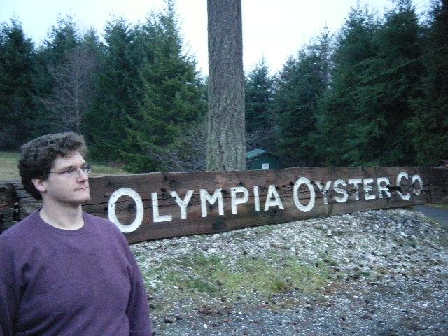
Brief History of Olympia Oysters
Ostrea lurida Native to Puget Sound
Culturally & Commercially Important
Heavy Declines
Promoted for Restoration in Washington Shellfish Initiative

Slide 5
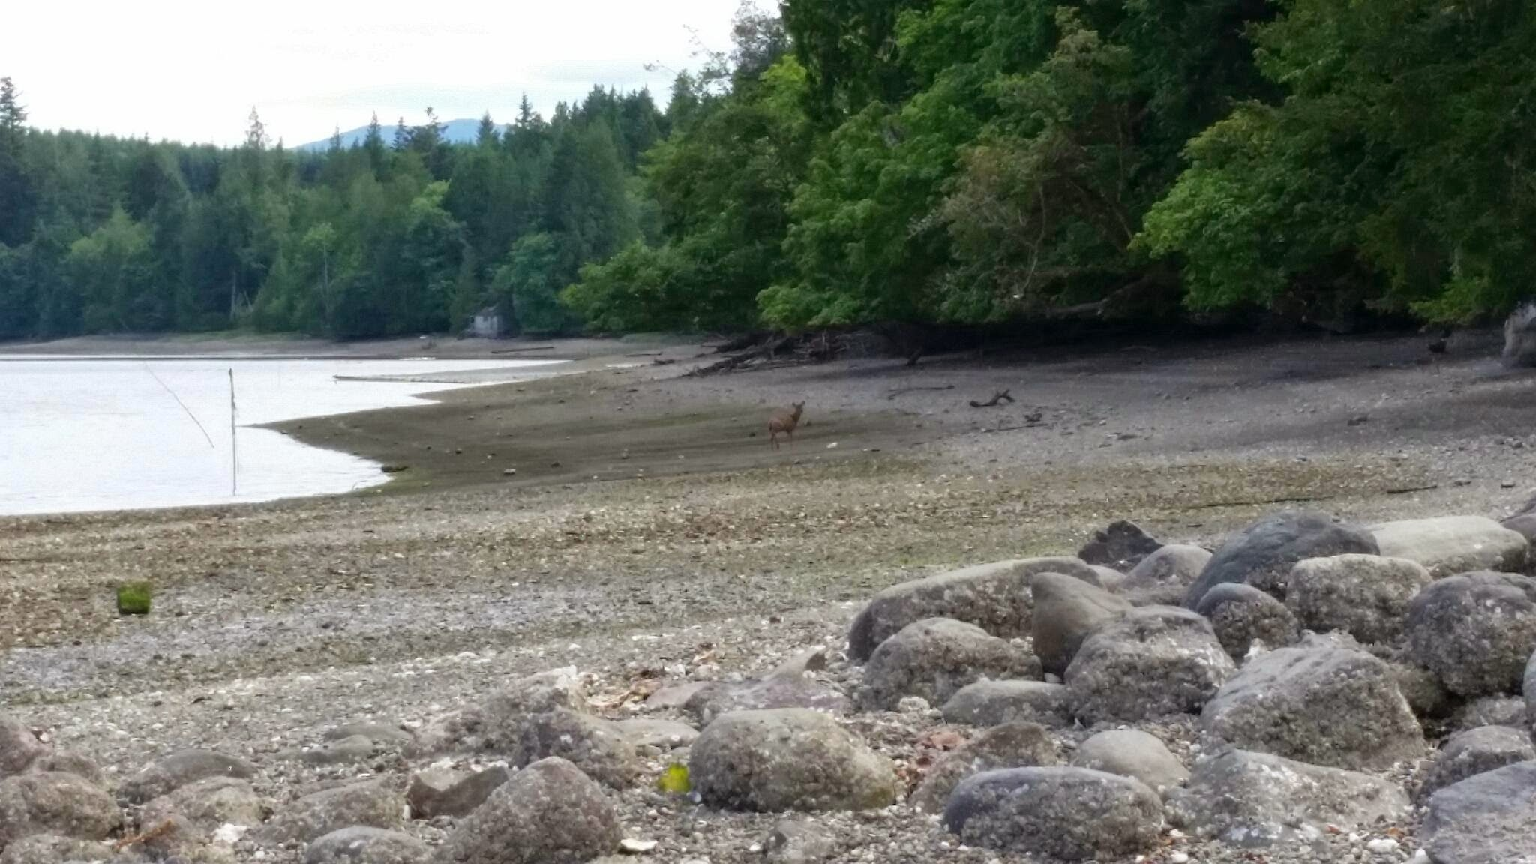
Why Local Stocks May Be Important
Assumed Adaptation
No Scale
Bay or Region?
Ensure Success

Slide 6
Outline
Why Local Stocks?
Experiment
Results
Conclusion

Slide 7
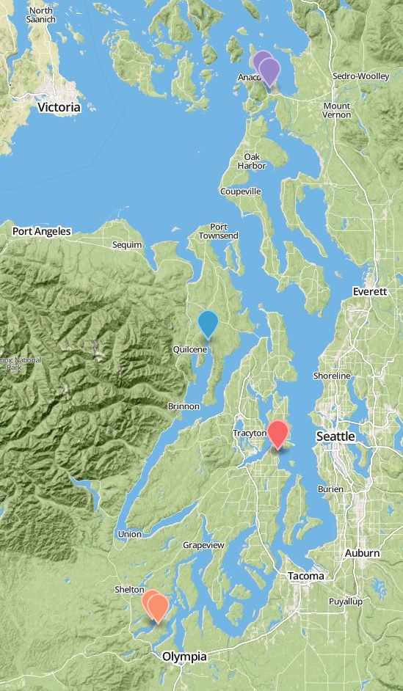
Experiment Basics
Fidalgo Bay
Reciprocal Transplant
Monitor
  3 Groups
  4 Sites
  1 Year
3 Home Sites
1 Foreign Site
Dabob Bay
Manchester
Oyster Bay

Slide 8
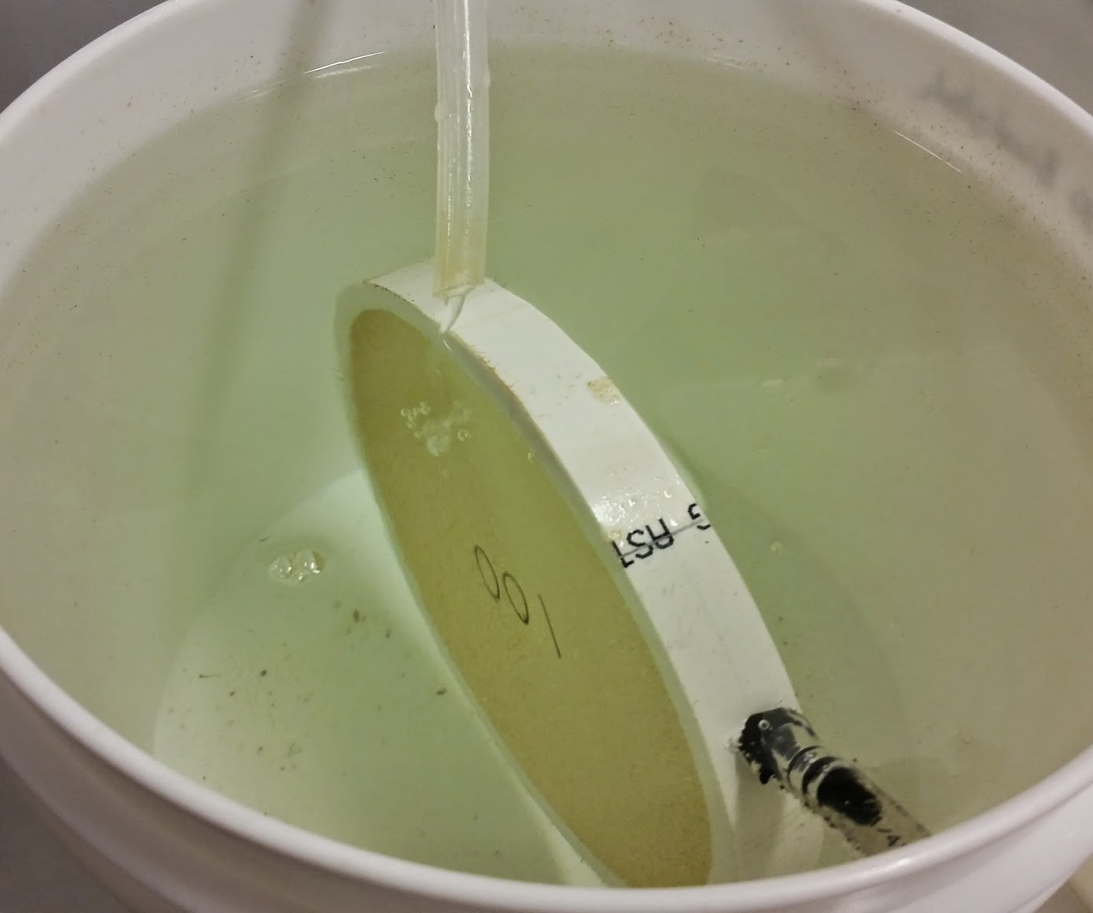
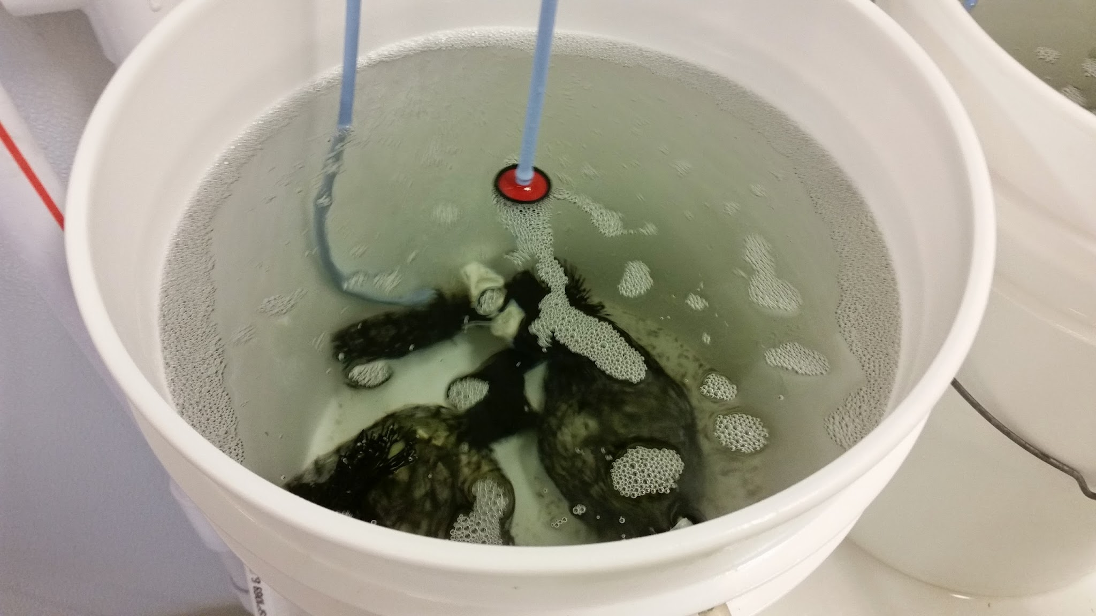
Broodstock and Outplanting
Broodstock
Collected by PSRF
Conditioned at Port Gamble
June 2013
Outplant
Larvae cultured by PSRF
Common Garden Conditions
August 2013

Slide 9
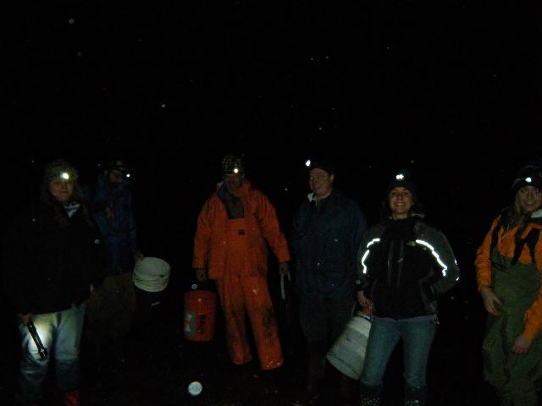
Winter Field Work
Visited 2-4 Months
Collected Dead
Counted Live
Imaged for Size
Maintained Trays

Slide 10
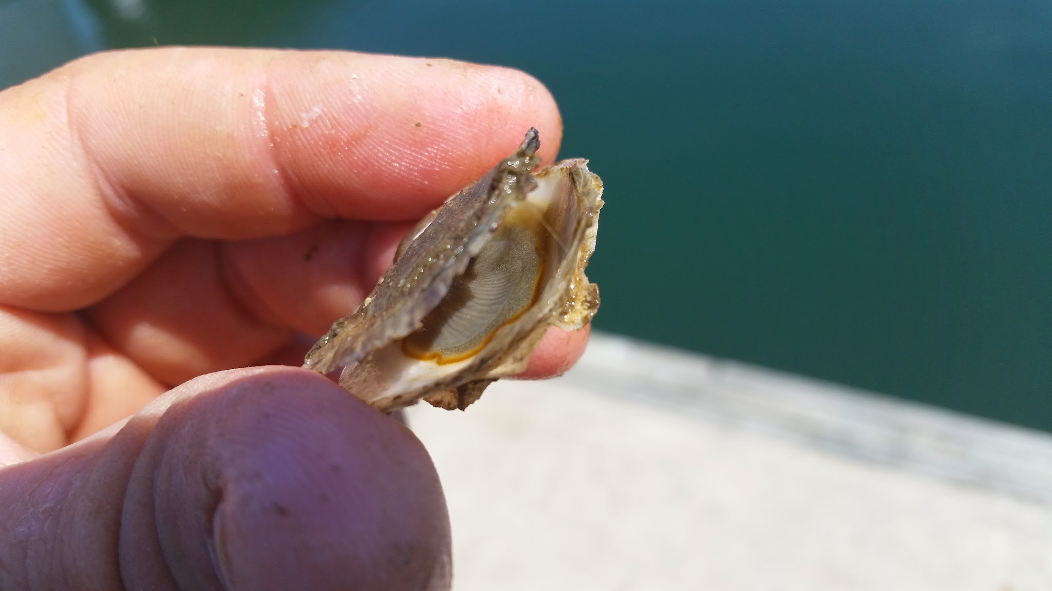
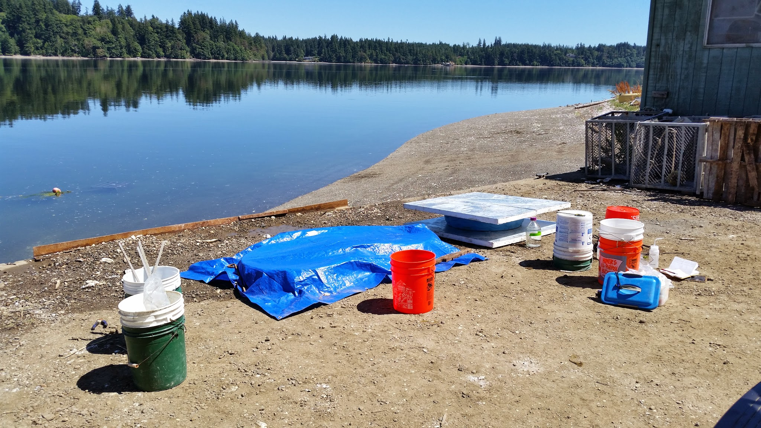
Summer Field Work
15 Weeks
Sampled Brooders
Collected Broods
Hopkins et al. 1936

Slide 11
Key Metrics
What We Want:
Fitness Correlates
Easily Identified
Monitorable
Possible Adaptive Advantage
What We Chose:
Mortality
Growth
Reproduction

Slide 12
Expectations
No difference
Home Field Advantage
Uber-Oyster
???
All Groups Equally Successful
Groups Only Successful at Home
One Group Outperforms
Mixed Results

Slide 13
Outline
Why Local Stocks?
Experiment
Results
Conclusion

Slide 14
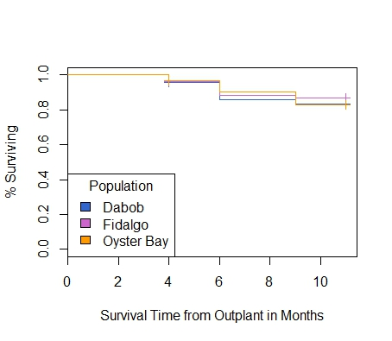
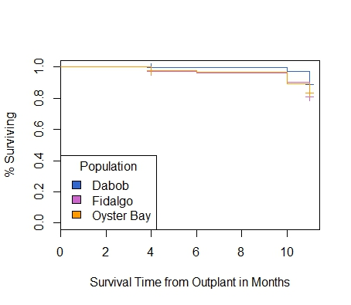
1.0
0.5
0
Fidalgo
Aug Oct Dec Feb Apr June
1.0
0.5
0
Manchester
Mortality
Aug Oct Dec Feb Apr June
Notes:
Make into two slides

Slide 15
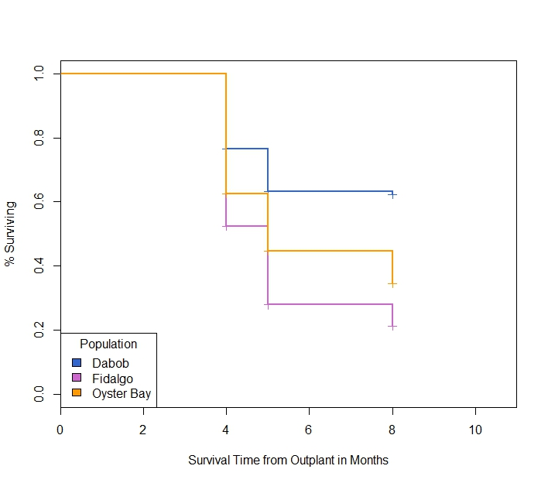
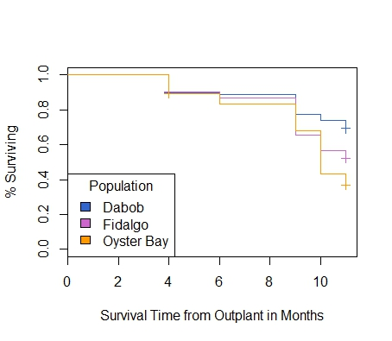
1.0
0.5
0
Dabob
Dabob
Aug Oct Dec Feb Apr June
1.0
0.5
0
Oyster Bay
Mortality
Aug Oct Dec Feb Apr June
Notes:
Make into two slides

Slide 16
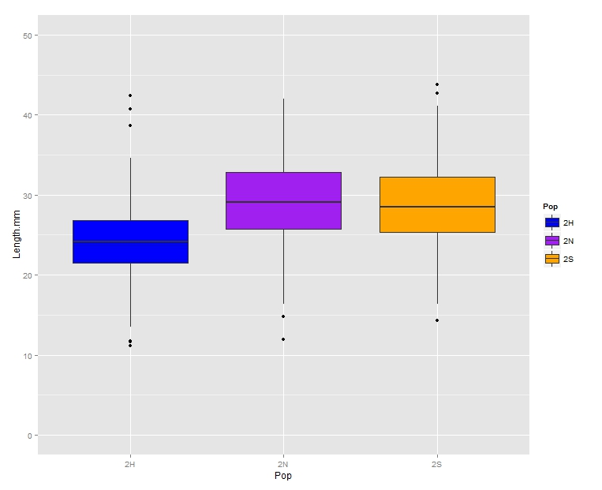
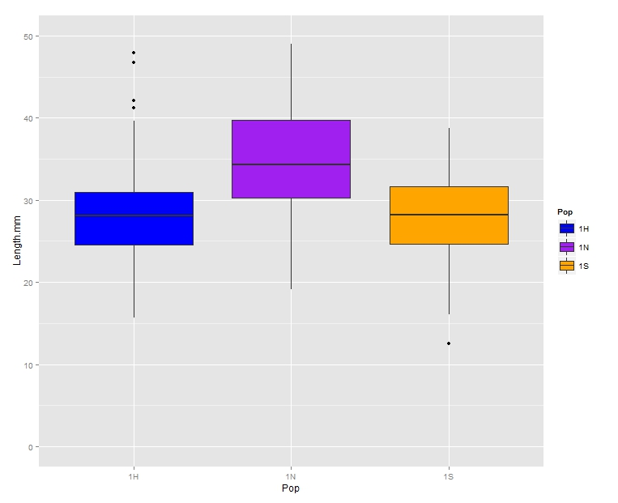
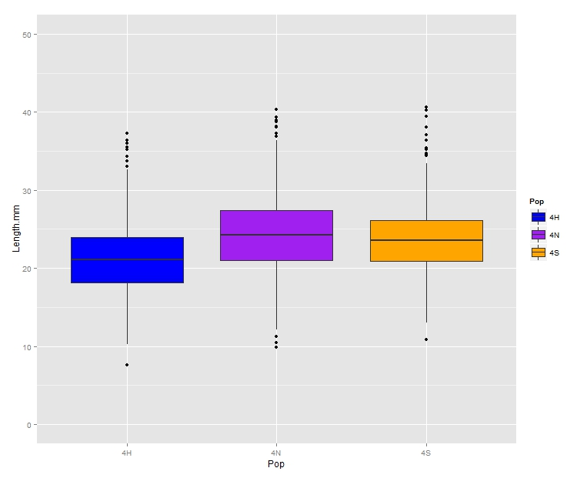
Outplanted Populations
50
30
10
Dabob
Group
Fidalgo
Fidalgo
Group
Oyster Bay
Group
Dabob
50
30
10
50
30
10
Manchester
Oyster Bay
Fidalgo
Dabob
Growth

Slide 17
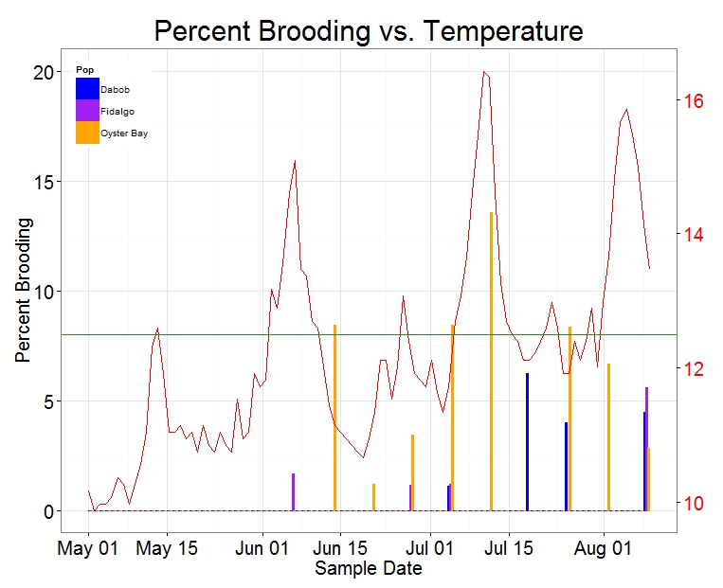
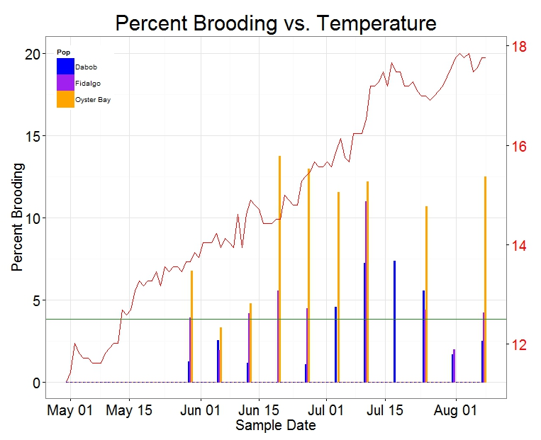
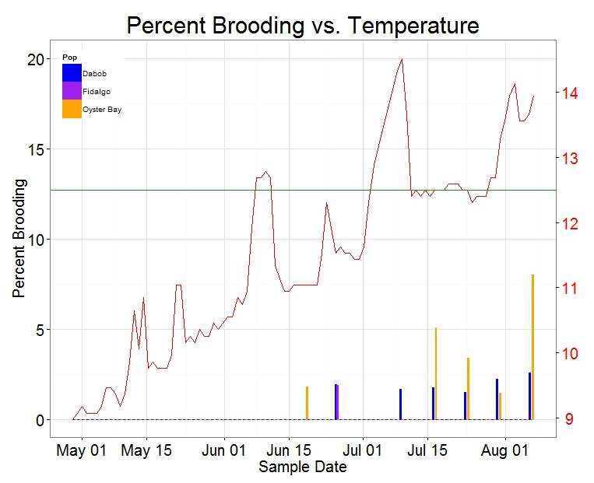
Outplanted Populations
15
10
5
0
Dabob
Group
Fidalgo
Fidalgo
Group
Oyster Bay
Group
May June July Aug
15
10
5
0
Manchester
Oyster Bay
Reproduction
May June July Aug

Slide 18
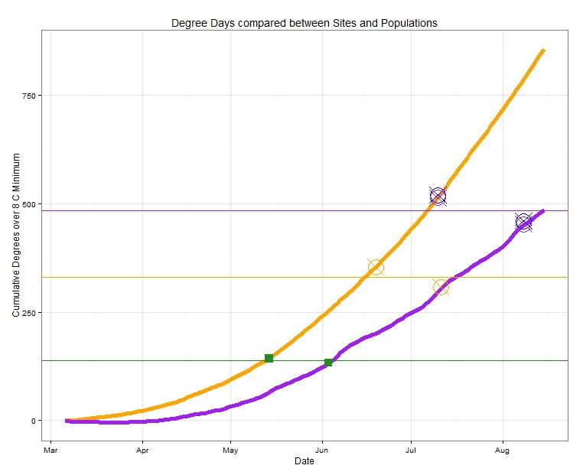
Population/Site Interaction
750
500
250
0
Oyster Bay Site
Difference in DD
Fidalgo Site
AVG Fidalgo/Dabob Peak Spawn 483.01 DD
151.985
AVG Oyster Bay Peak Spawn 331.025 DD
193.025
12.5 C Spawn Threshold 138 DD
Mar Apr May June July Aug
Notes:
Cushing’s Match-Mismatch Hypothesis

Slide 19
Outline
Why Local Stocks?
Experiment
Results
Conclusion

Slide 20
Expectations Vs. Reality
Equality?
Home Field Advantage?
Uber-Oyster?
???
No
No
No
No Clear Winner/Loser?

Slide 21
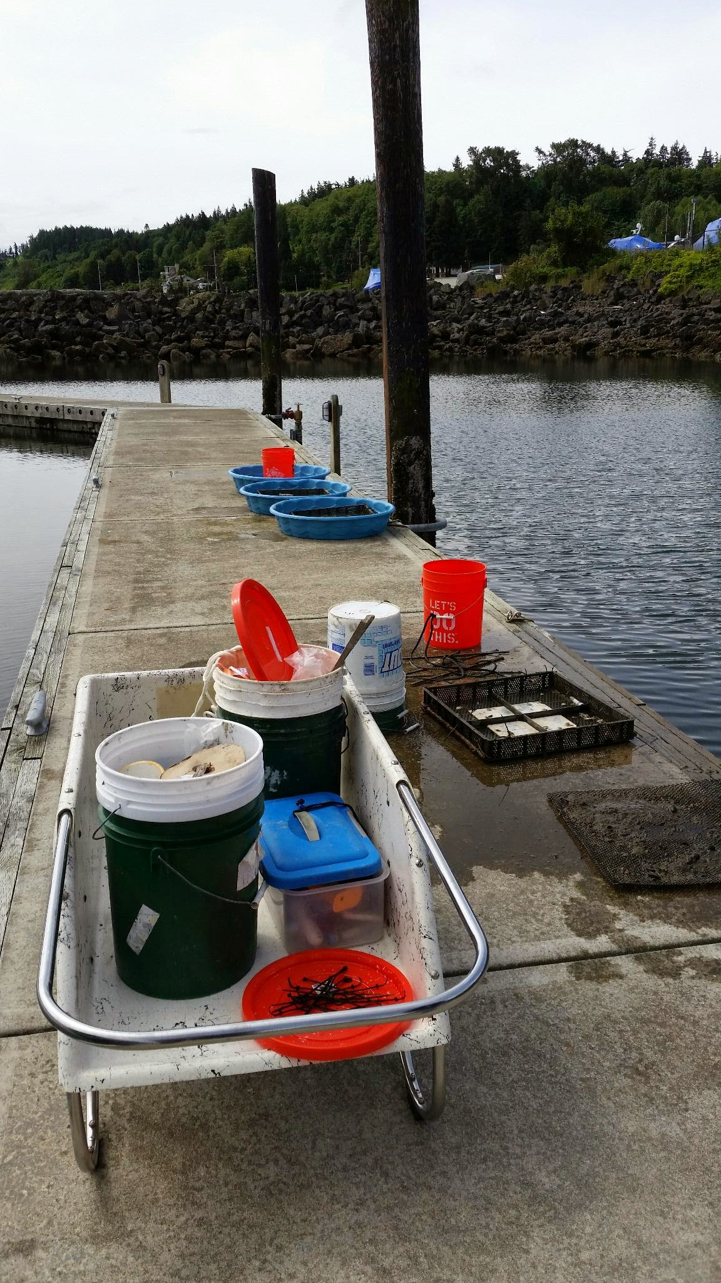
Summary
Mortality
  Dabob Survives Extremes
  Fidalgo High Mortality in Extremes
Growth
  Fidalgo Largest
  Dabob Smallest
Reproduction
  Oyster Bay Most Active
  Dabob Least Active

Slide 22
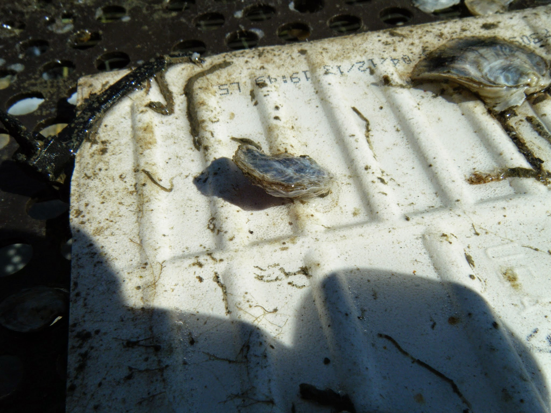
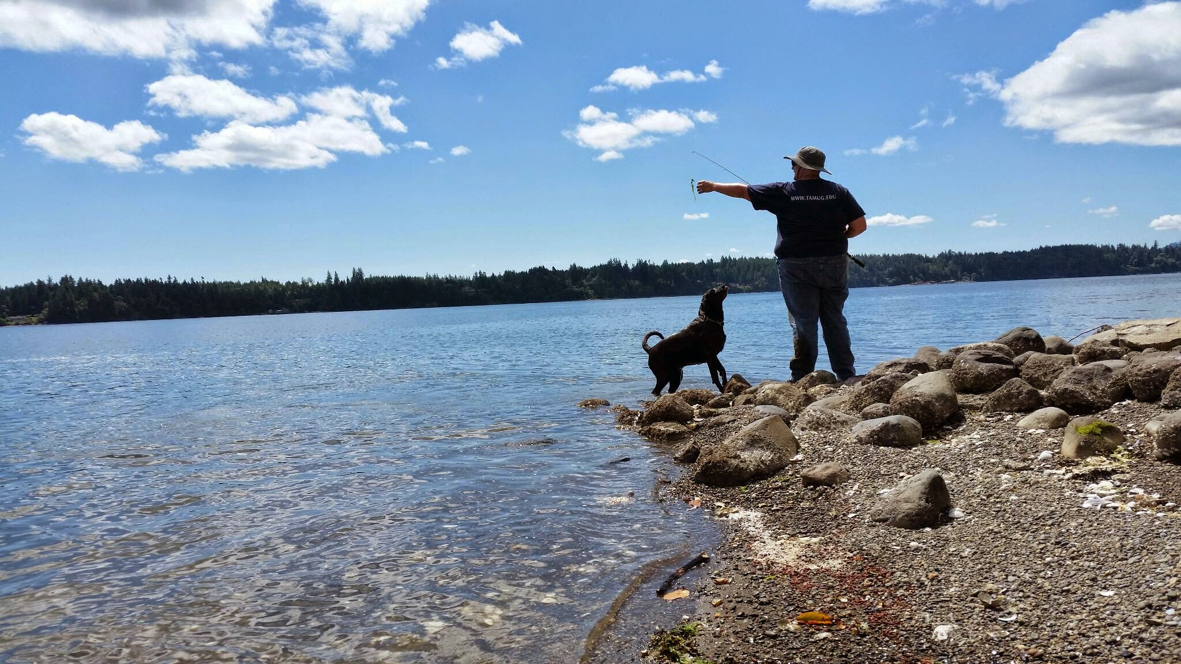
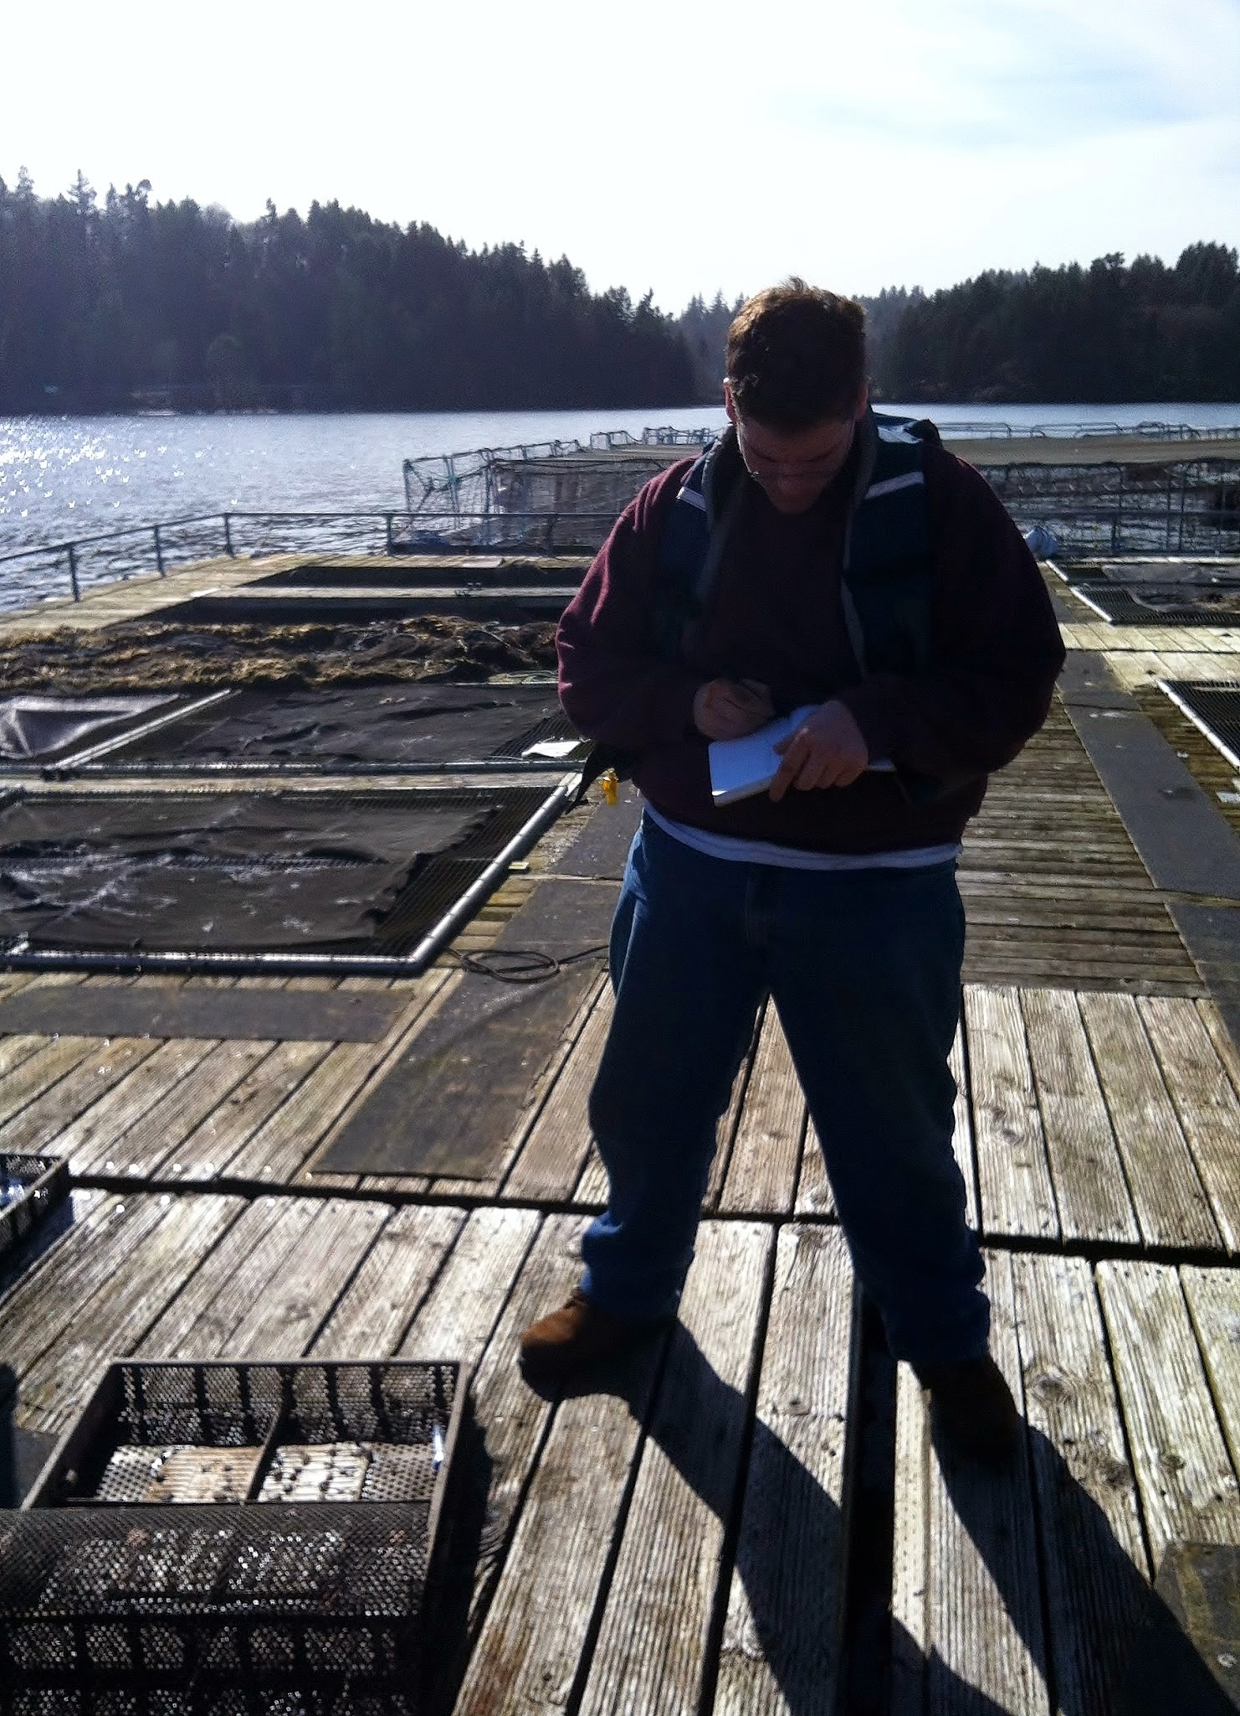
Future Research
Population Genomics
Fecundity

Slide 23



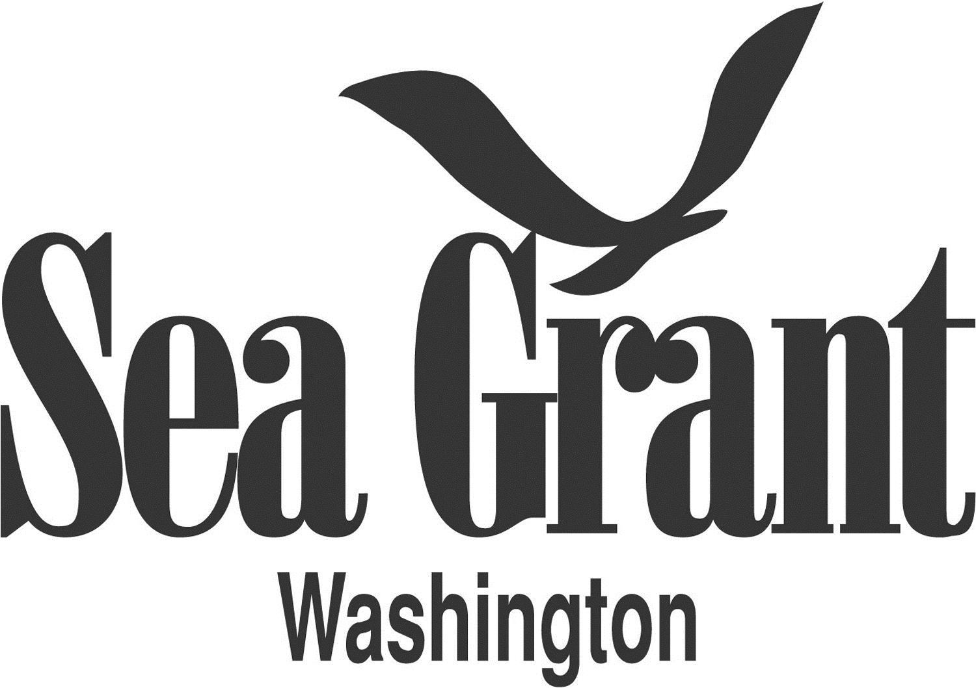

Acknowledgements

Slide 24
Acknowledgements
Roberts Lab:
Sam White
Claire Olson
Mackenzie Gavery
Emma Timmins-Schiffman
Grace Crandall
Jonathon Allen
Etilet Maipi
Samantha Adams
Hannah Wear
Jessica Richards
Katie Jackson
Andy Jasonowicz
Doug Immerman
Giles Goetz
PSRF:
Ryan Crim
Brian Allen
Betsy Peabody
Stuart Ryan
WDFW:
Brady Blake
Crab Fresh:
Brendan Mahaffey
Jeff Koenings
Rick Tweed
Hatchery Crew
Fidalgo Marina:
Einar Sortun
Yacht Owners
Taylor Shellfish:
Molly Jackson
Sara Wykoff
Ed Jones
NOAA:
Rick Goetz
Dive Team
Netpen Crew
Fagergren Family
Rockpoint Oyster Company:
Dick Steele
Crew
Miscellaneous:
L. Christine Savolainen
Sean Bennet
Joelle Blais
Joe Stevick
Bethany Stevick
Lisa Crosson
Alicia Godersky
Lea Savolainen
Photo Credits:
Jake Heare
L. Christine Savolainen
Steven Roberts
Sam Adams

Slide 25
Follow My Research!
Blog:
heareresearch.blogspot.com
Twitter:
@HeareBraindIdea
Roberts Lab:
genefish.wikispaces.com
Facebook:
facebook.com/pages/Roberts-Lab

Slide 26
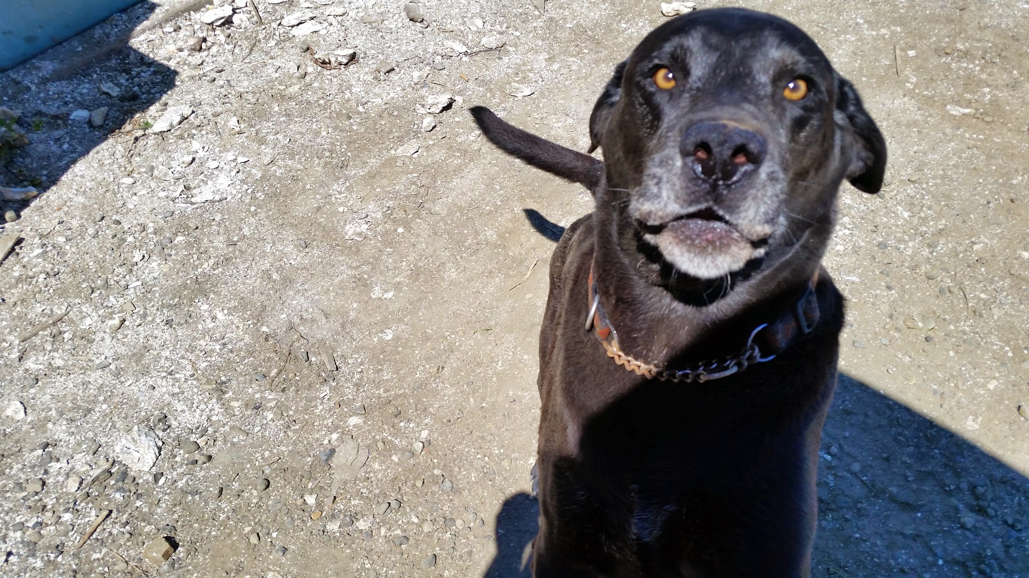
QUESTIONS!
SPECIAL THANKS
TO
JACK
!!!!!!!

Slide 28
Implications
If:
Equality
Homefield Advantage
Uber-Oyster
???
Then:
All Work
Select Based on Site
Easy Choice
Best Guess
Notes:
If, Then statements

Slide 29
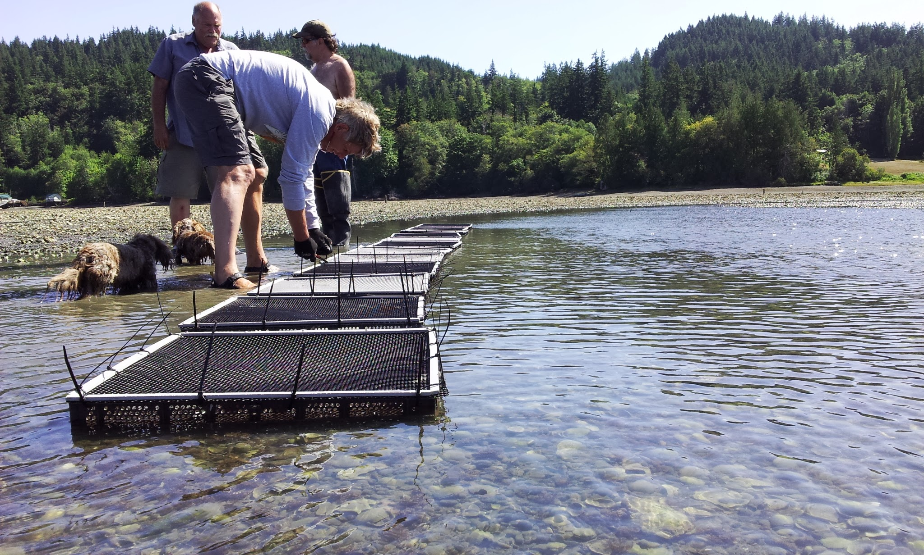
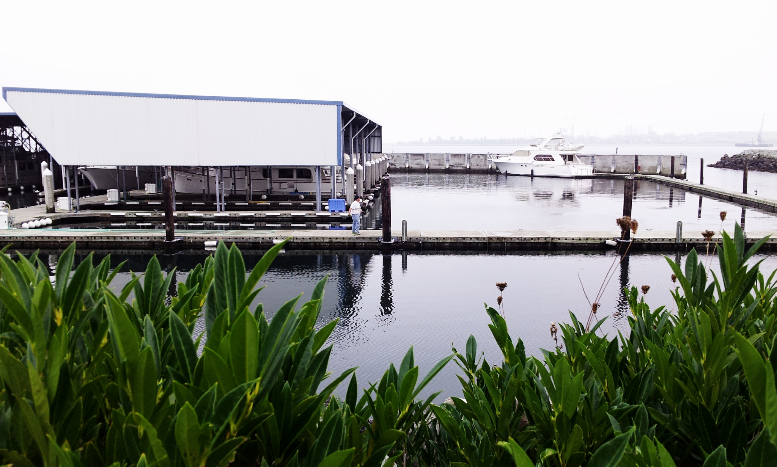
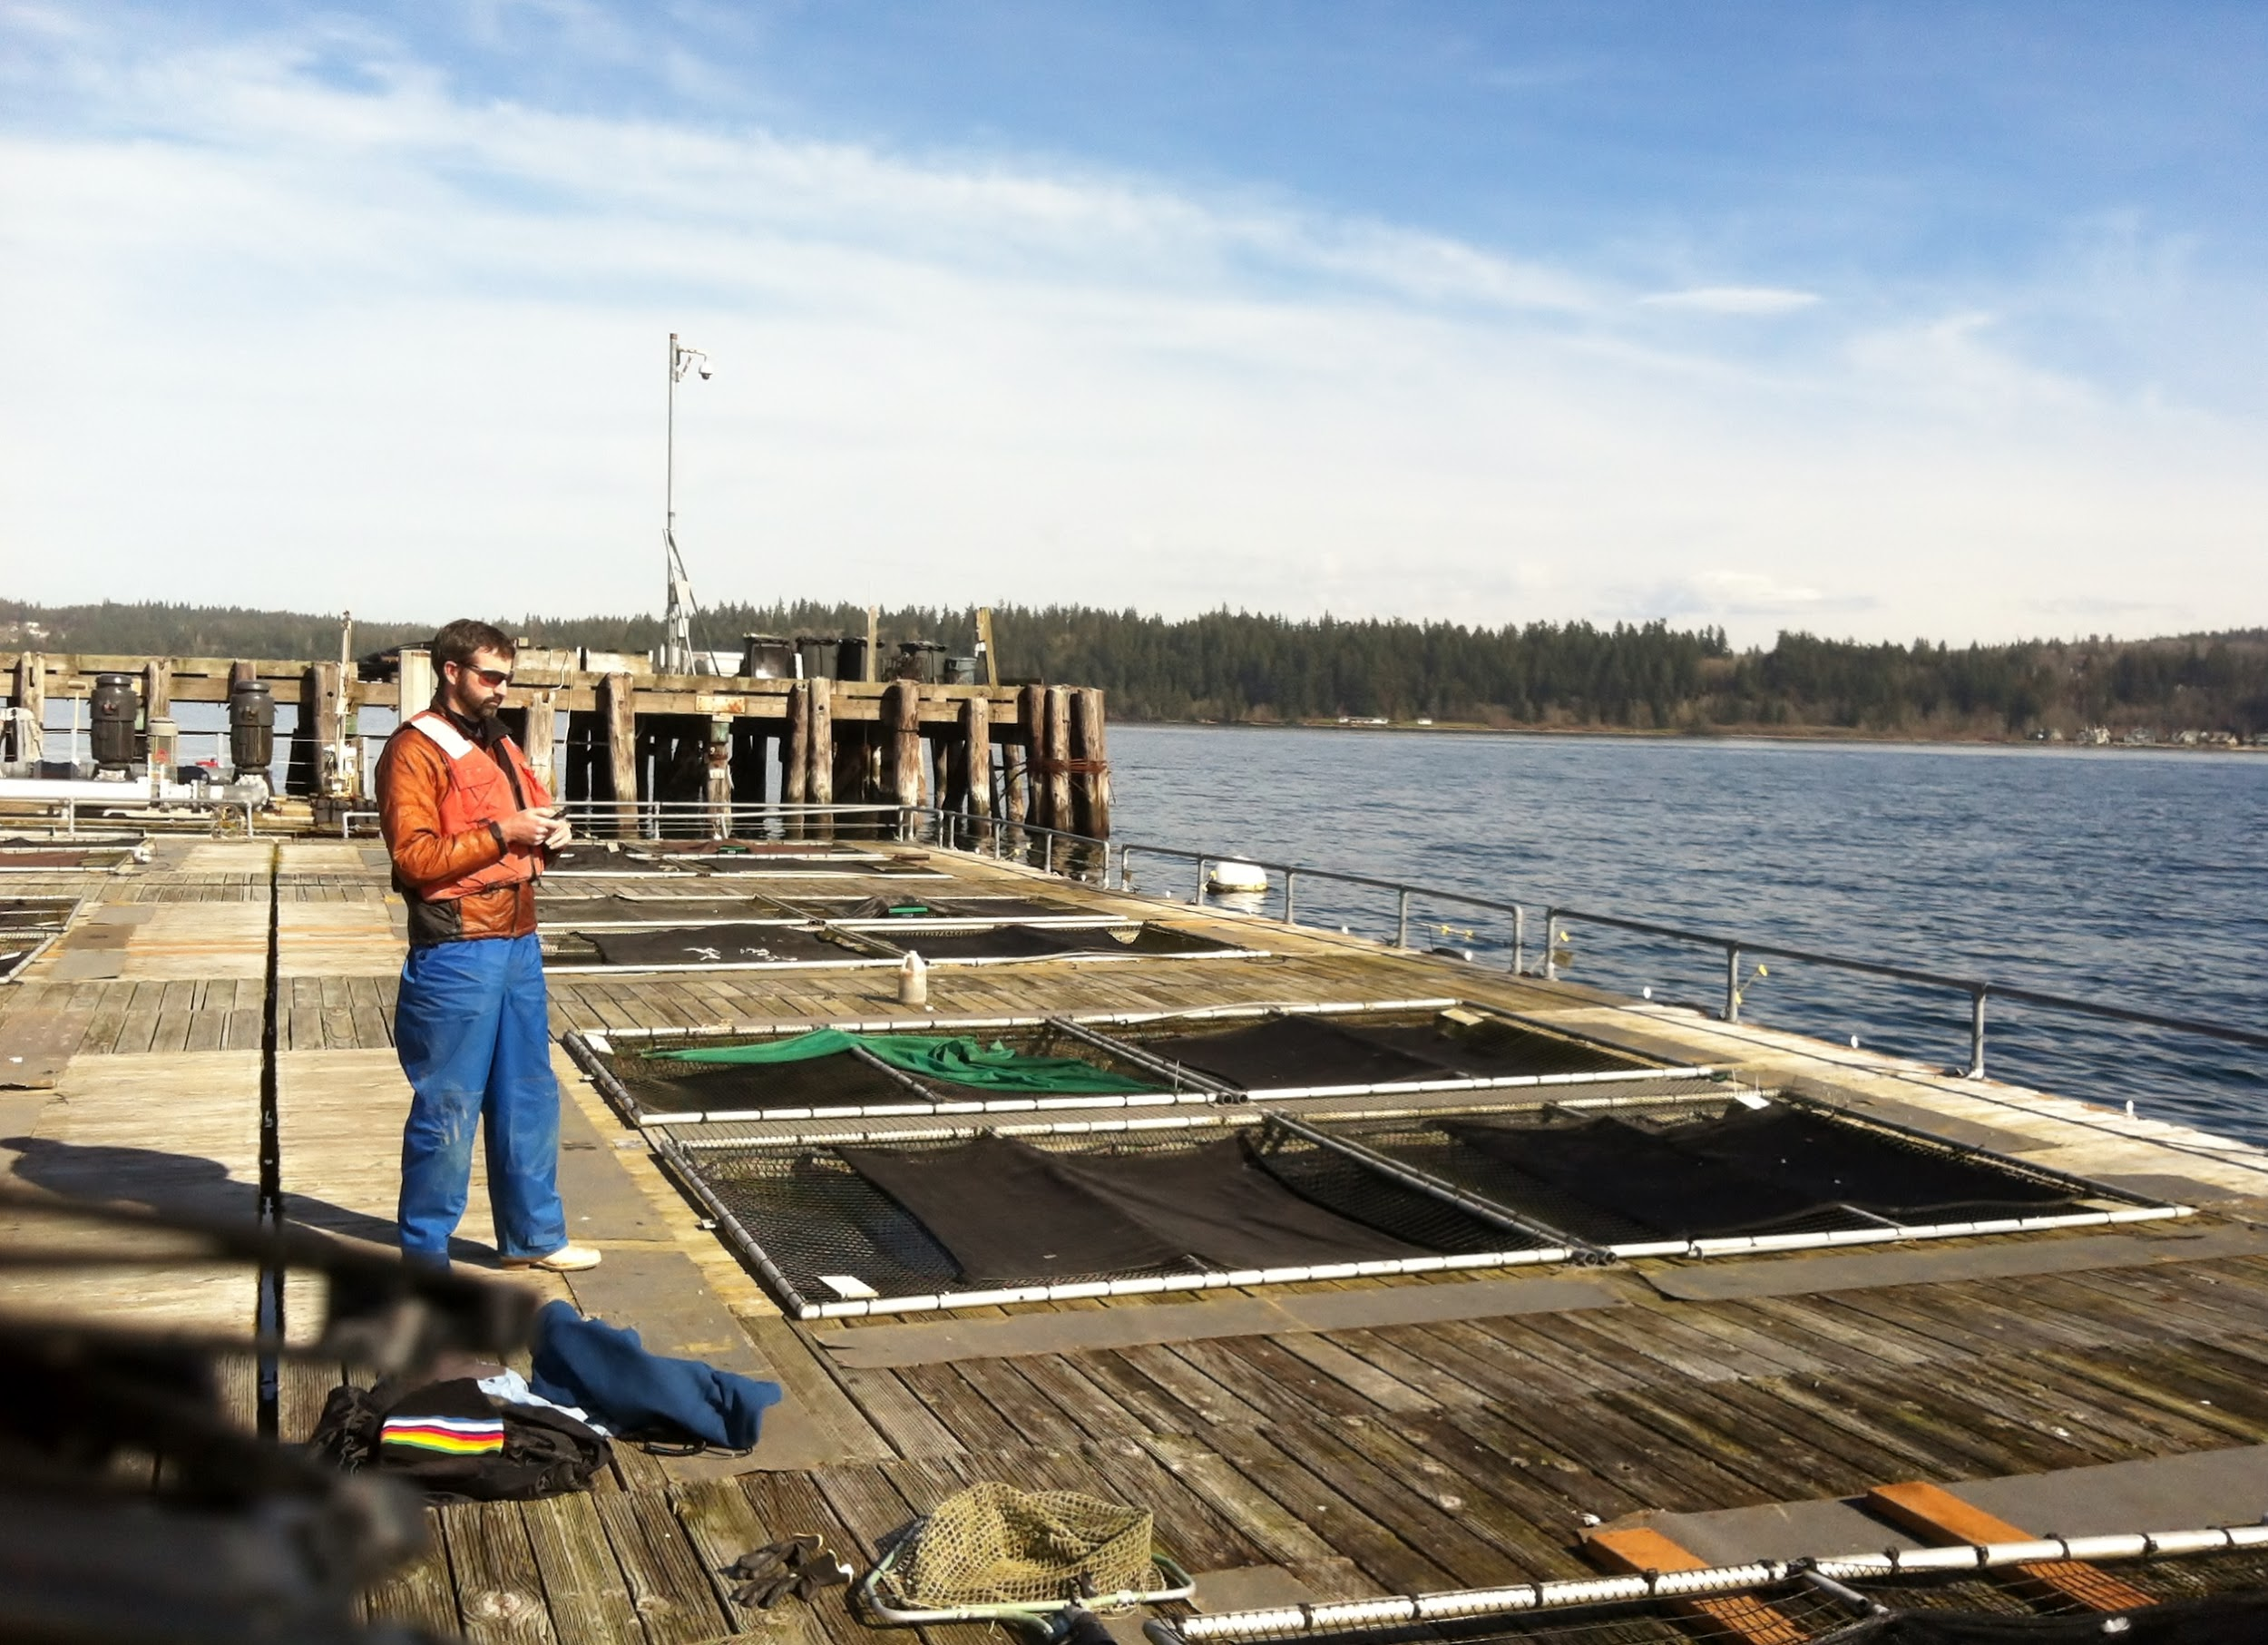
Sites
Dabob Bay
Fidalgo Bay
Oyster Bay
Manchester

Slide 30
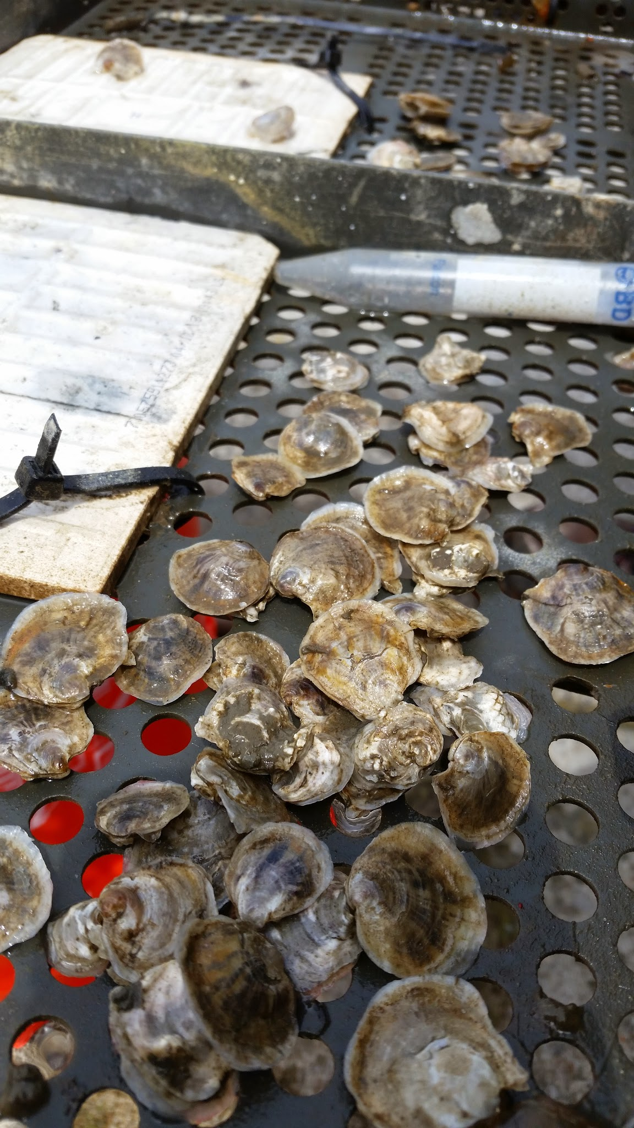
Why Local Stocks?
Dwindling Native Populations
Improve Habitat Viability
Better Adapted?

Slide 31
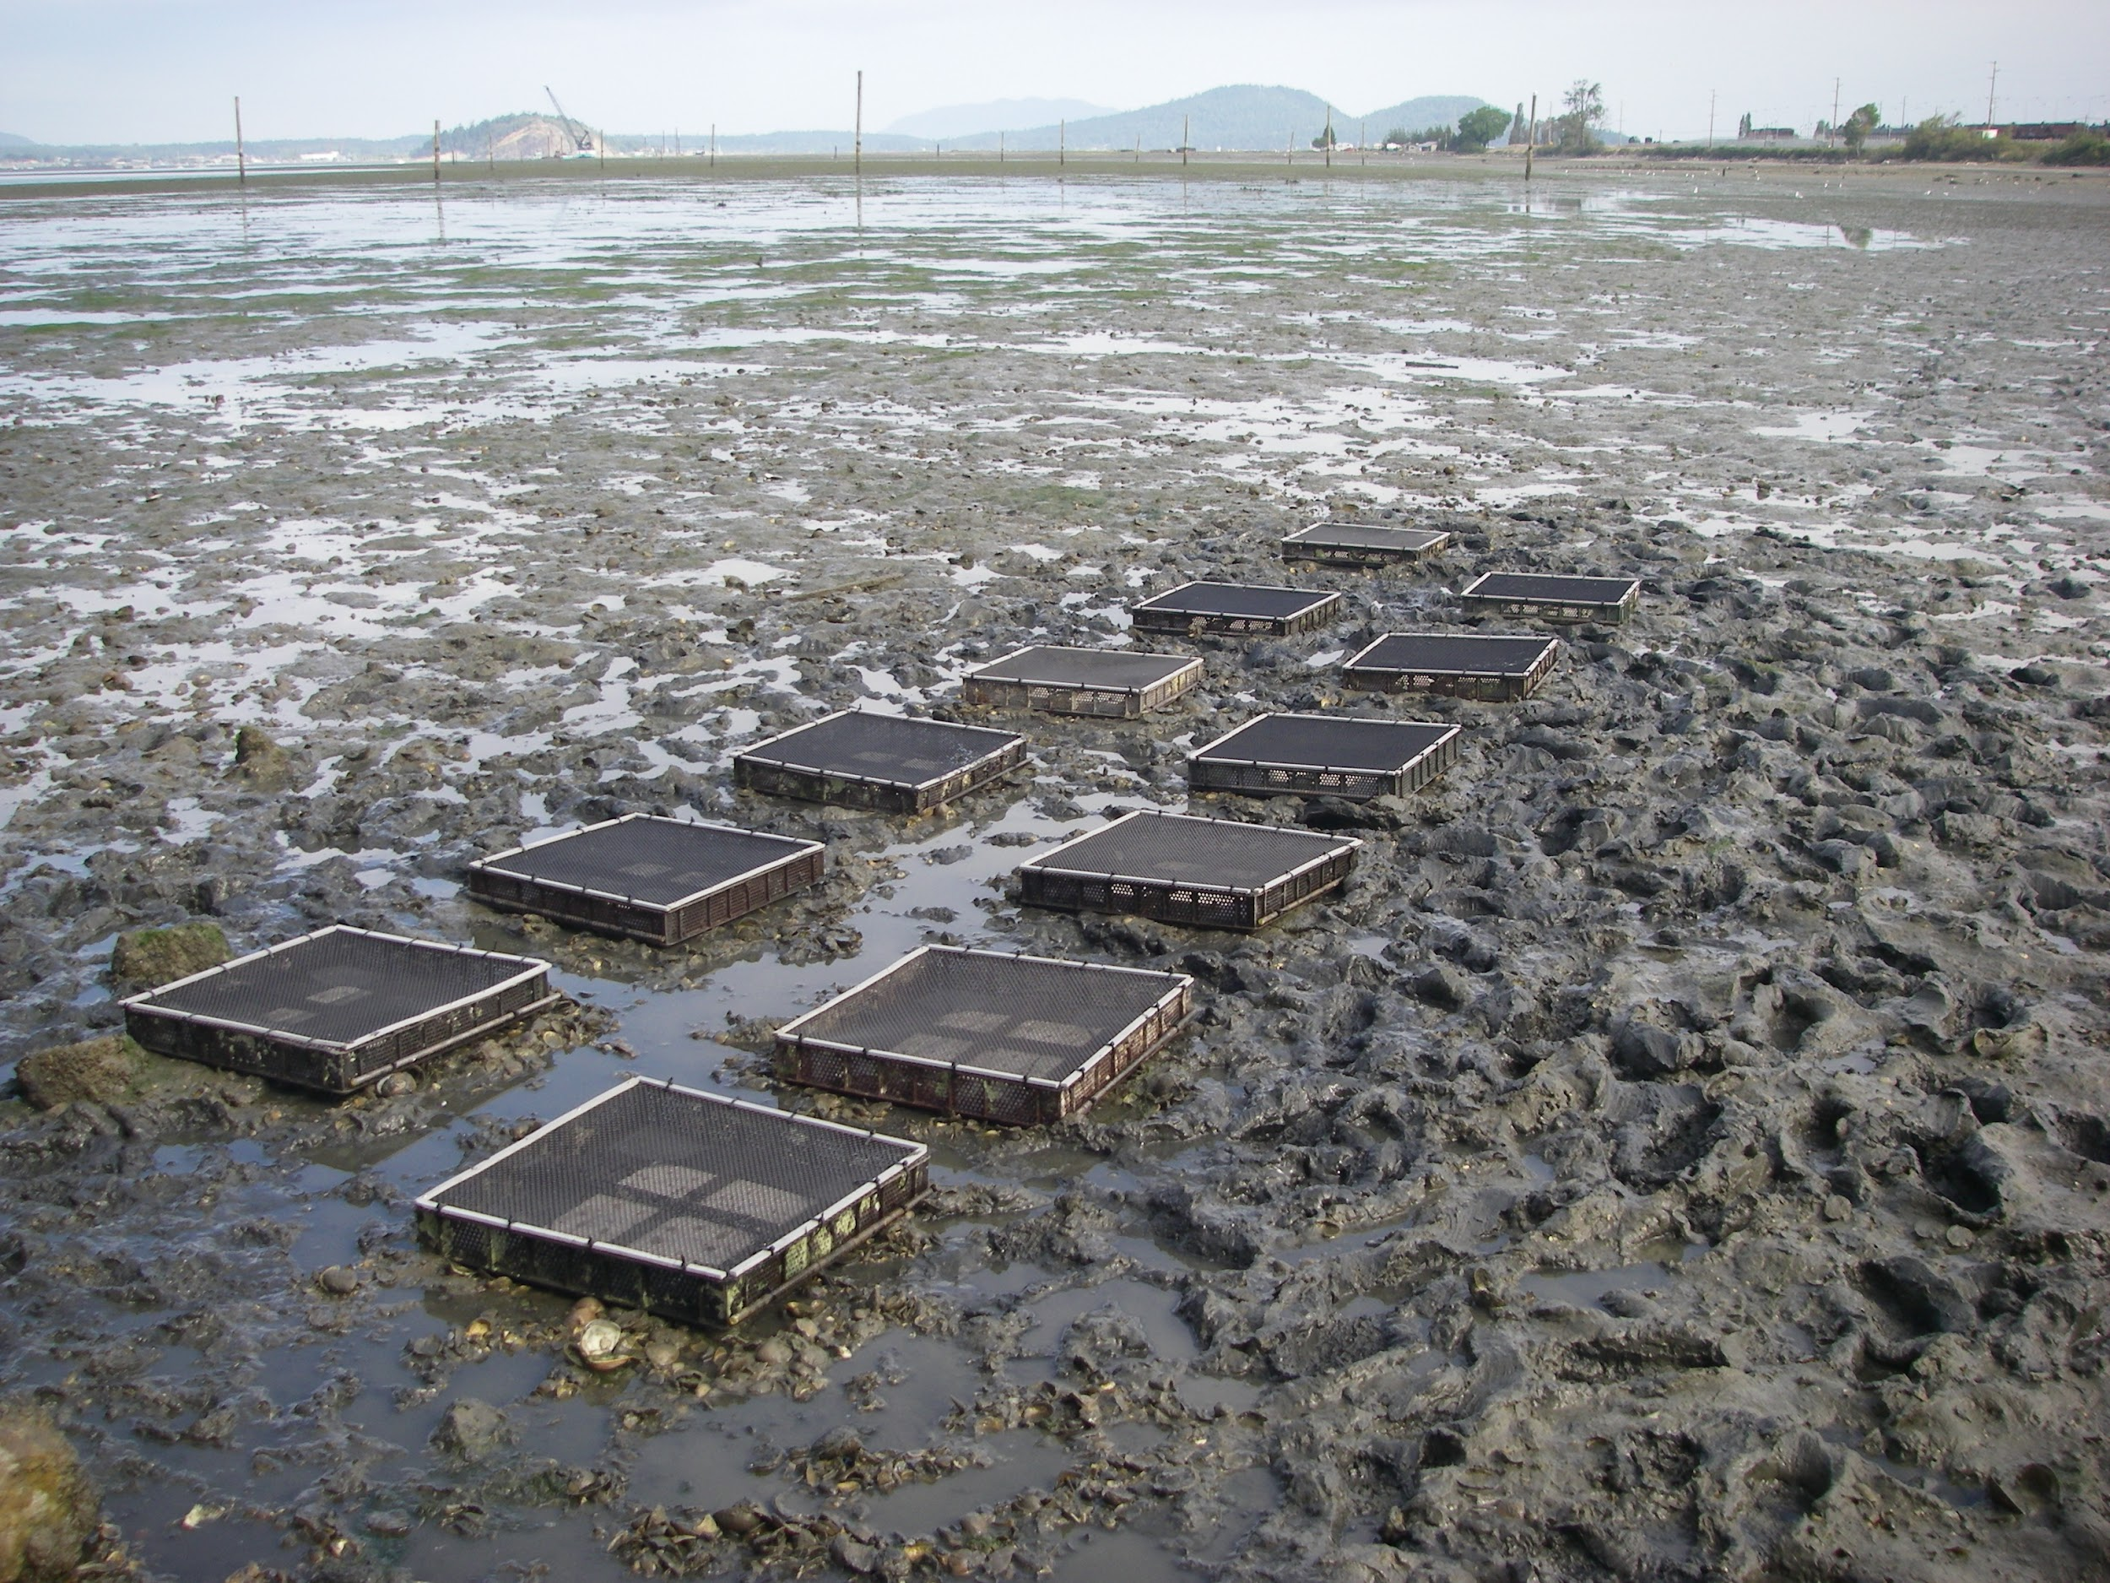
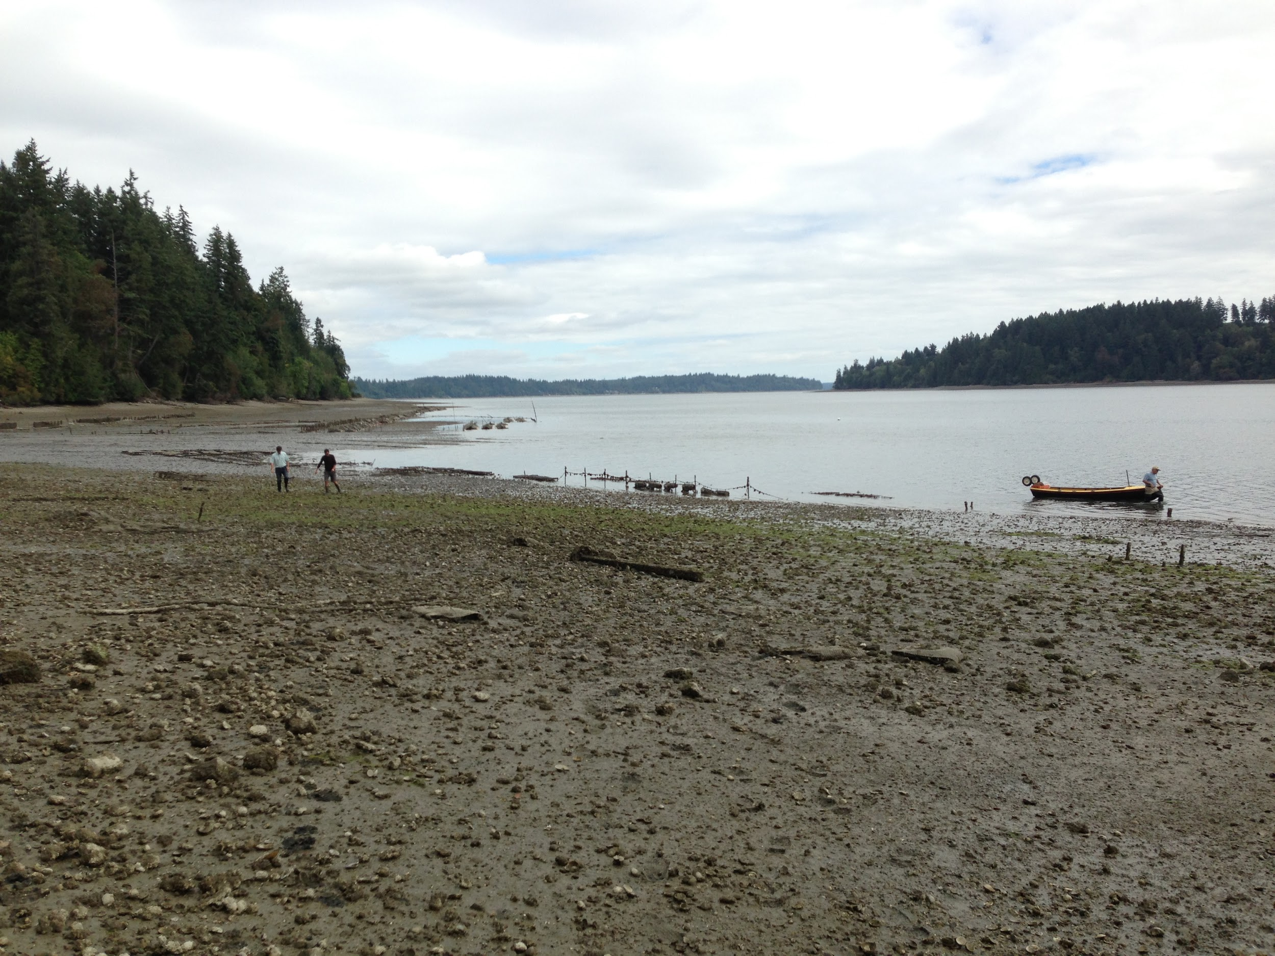
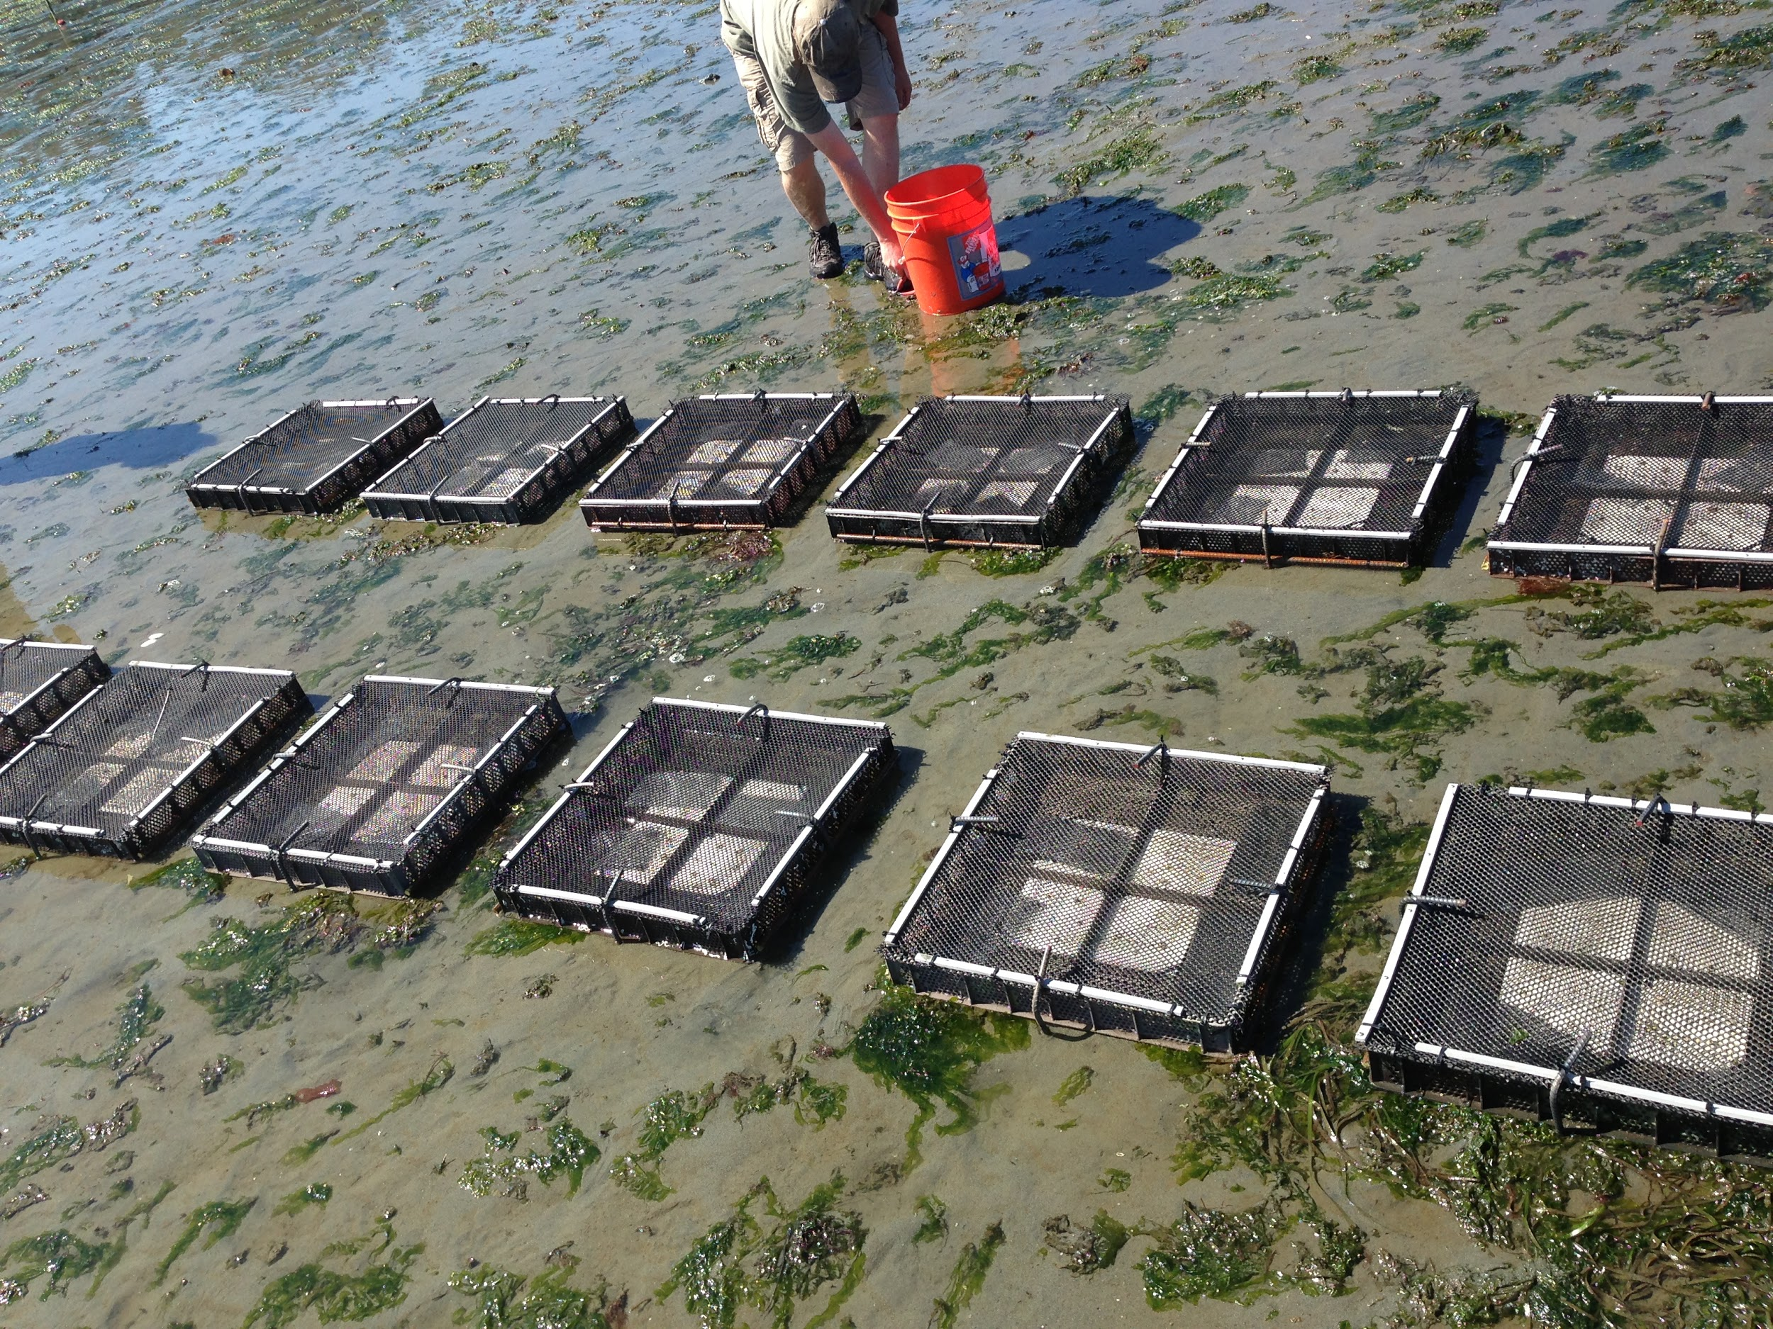
Dabob Bay
Fidalgo Bay
Oyster Bay
Manchester

Slide 32
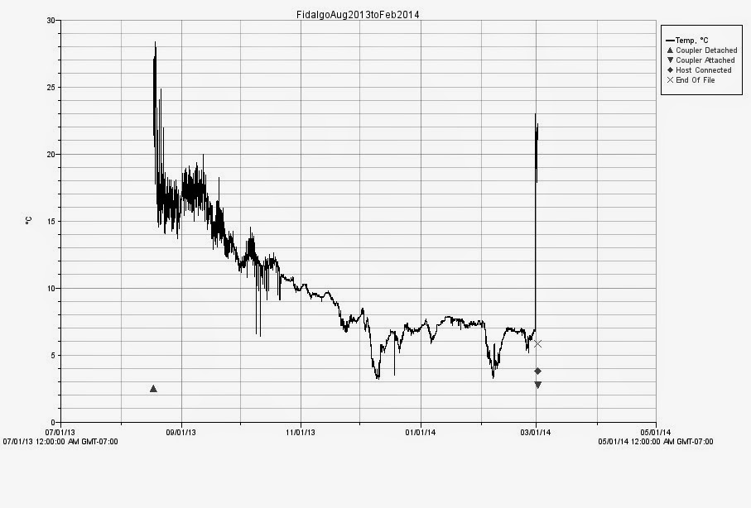
The Big Move
Manchester, Fidalgo, and Oyster Bay
Unforeseen Temperature Extremes
Ensure Survival
Moved from Intertidal to Subtidal

Slide 33
Adaptation to Local Environments
Important to Native Species
Reduces Negative Impacts
  Heat
  Salinity
  DO
Increases Advantages
  Opportunistic
  Energy Allocation
  Spawn Timing
Possible Impact on Outplanting

Slide 34
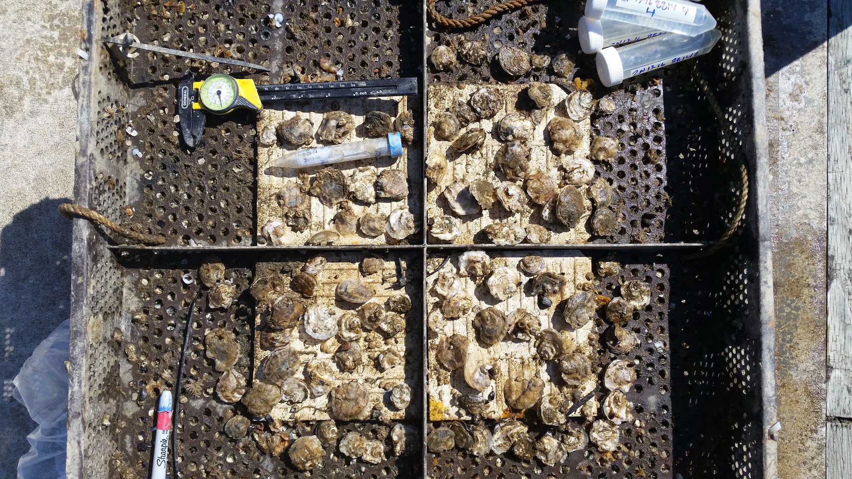
Testing for Adaptation
Reciprocal Transplants
Longitudinal Axis
Origin Bays
  Historic Significance
  Dynamic Environment
  Active Restoration
PSRF Animal Husbandry
F1 generation

Slide 35
Map
Sites located on North-South Axis
Purple = Fidalgo
Blue = Dabob
Orange = Oyster Bay
Red = Manchester*
*Manchester only has transplants.
Interactive map can be accessed here:
http://bit.ly/1l2vNu6
10 miles

Slide 36
What Are We Looking For?
Apparent Differences
Three Key Factors
  Mortality
    Hardiness
  Growth
    Predator Defense
    Reproduction
  Spawning
    Recruitment
    Future

Slide 37
Stages of Outplant Advantage
Broodstock &
Outplantation
Survival & Growth
Advantage
Spawning Advantage
Population Genetic Profile
Stability
Important Year 0
Important Years 1-2
Important Years 1-5
Determines Future Success
Determines
Outplant Survival Success
Determines
Recruitment
Success
Determines
Long term Population
Stability

Slide 38
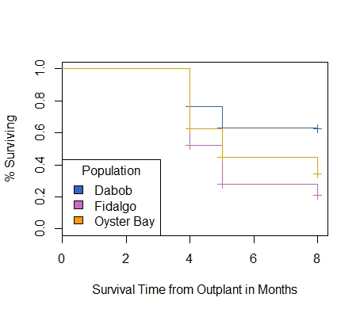
Differences in Mortality
Oyster Bay
Dabob*
Fidalgo
Manchester

Slide 39
Map
Sites located on North-South Axis
Purple = Fidalgo
Blue = Dabob
Orange = Oyster Bay
Red = Manchester*
*Manchester only has transplants.
Interactive map can be accessed here:
http://bit.ly/1l2vNu6
10 miles

Slide 40
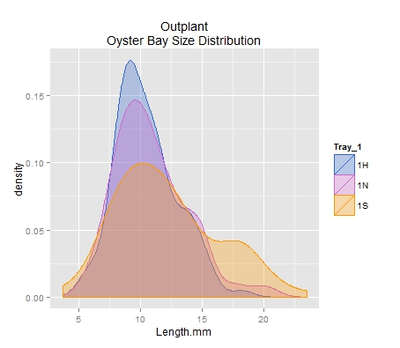
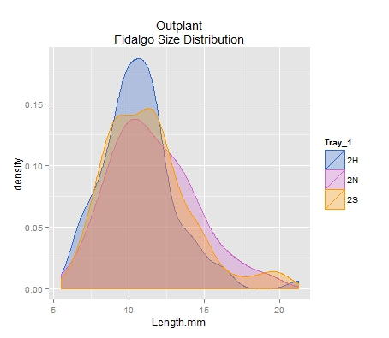
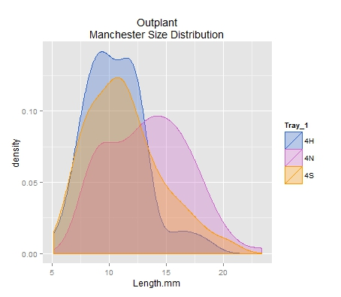
Differences in Growth: Outplant
Based on image analysis of images taken of oysters at outplant at each site. N=96 for each group at each site.

Slide 41
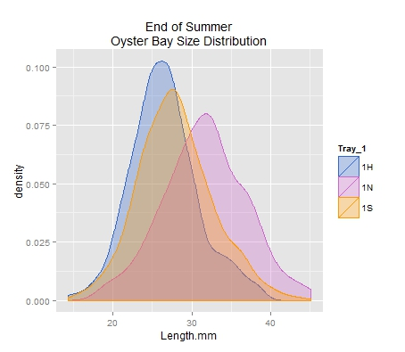
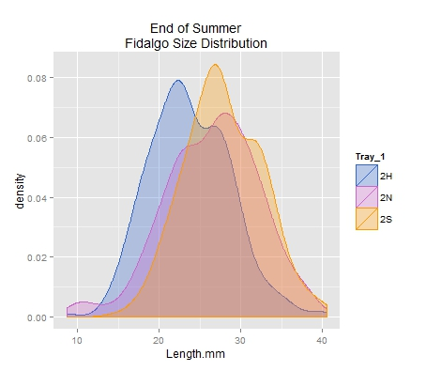
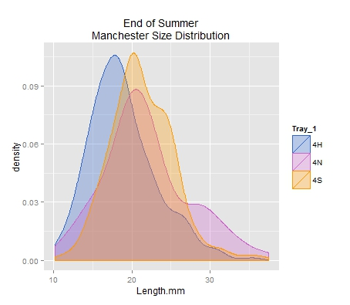
Differences in Growth: Summer
Size Distribution based on image analysis from images taken during July and August 2014.

Slide 42
Map
Sites located on North-South Axis
Purple = Fidalgo
Blue = Dabob
Orange = Oyster Bay
Red = Manchester*
*Manchester only has transplants.
Interactive map can be accessed here:
http://bit.ly/1l2vNu6
10 miles

Slide 43
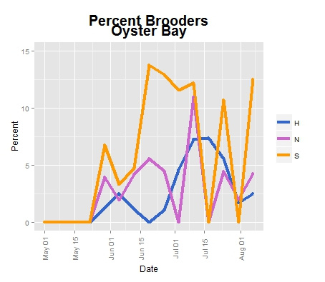
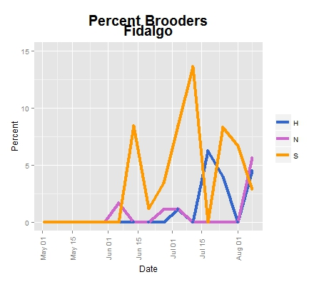
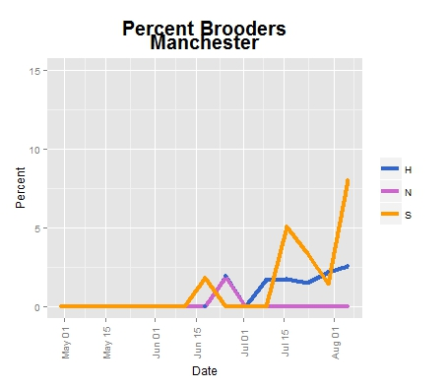
Differences in Spawning

Slide 44
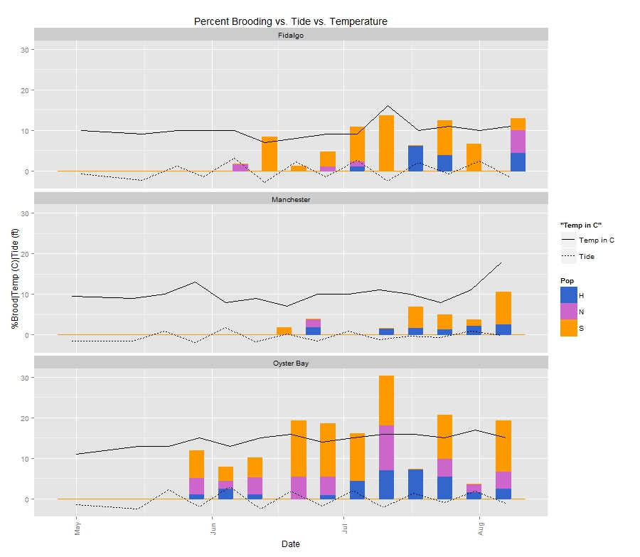
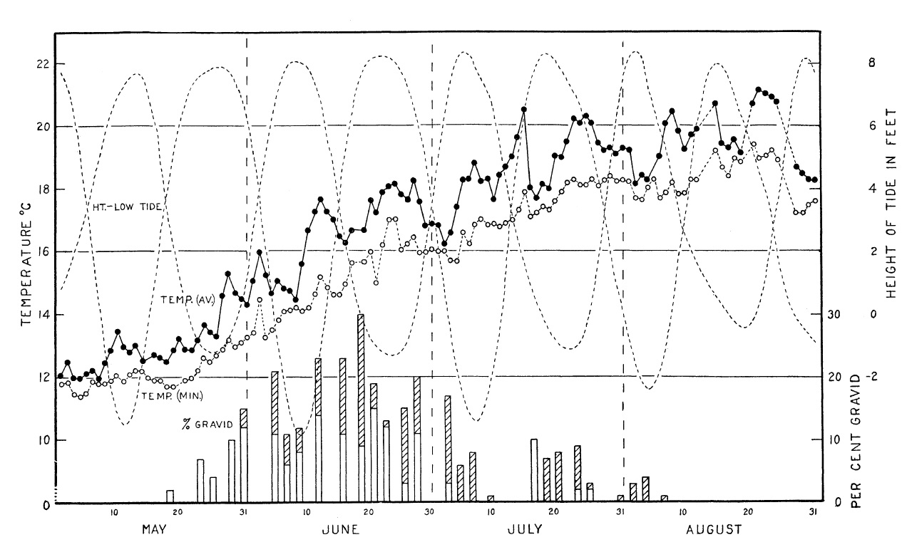
Tide and Temperature

Slide 45
Map
Sites located on North-South Axis
Purple = Fidalgo
Blue = Dabob
Orange = Oyster Bay
Red = Manchester*
*Manchester only has transplants.
Interactive map can be accessed here:
http://bit.ly/1l2vNu6
10 miles

Slide 46
Time, Temp, Site, Size

Slide 47
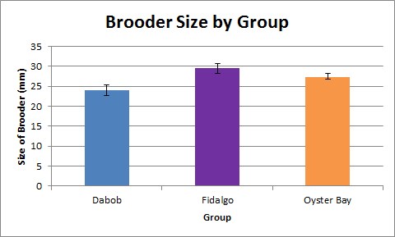
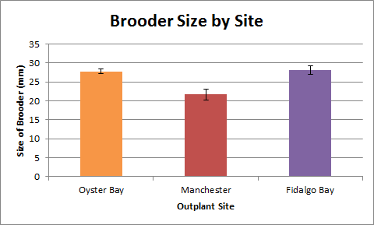
Spawning Size

Slide 48
Differences Summary
Mortality
  Driven by Site
  Tuned by Group
  Dabob Survives Extremes
  Fidalgo High Mortality in Extremes
Growth
  Driven By Site
  Tuned by Group
  Fidalgo Largest
  Dabob Smallest
Spawning
  Volume Driven by Site
  Tuned by Group
  Oyster Bay Most Active
  Dabob Least Active
Spawn Timing
  Driven By Site
  Delayed
Size at Spawn
  Driven by Site and Group
  Affects Spawner Volume

Slide 49
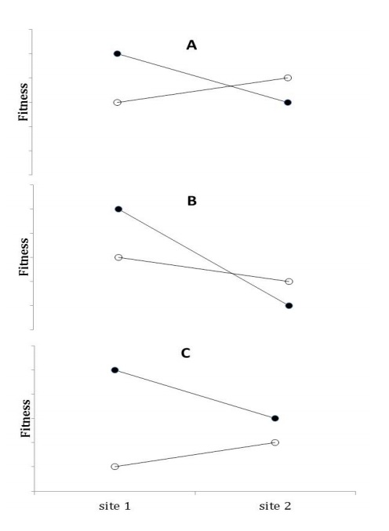
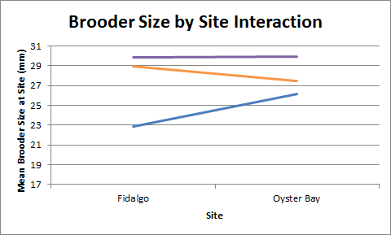
Possible Effects of Local Adaptation

Slide 50
Stages of Outplant Advantage
Broodstock &
Outplantation
Survival & Growth
Advantage
Spawning Advantage
Population Genomics
Important Year 0
Important Years 1-2
Important Years 1-5
Determines Future Success
Determines
Outplant Survival Success
Determines
Recruitment
Success
Determines
Long term Population
Stability

Slide 51




Oyster Bay
Dabob*
Fidalgo
Manchester
Mortality

Slide 52


Oyster Bay Size Distribution

Slide 53


Fidalgo Size Distribution

Slide 54


Manchester Size Distribution

Slide 55



Oyster Bay
Manchester
Fidalgo
Size Distribution

Slide 56


Number of Broods Produced

Slide 57


Percent of Sample Brooding

Slide 58
Percent Brood vs Size

